Slide 1


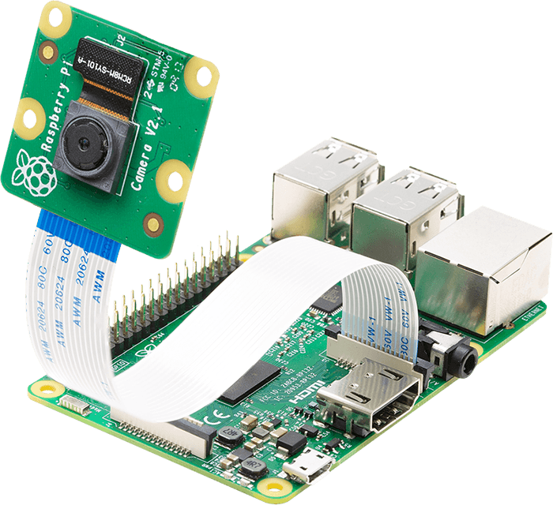
Development of iot-based solution for checking student attendance
Student 1: Nguyen Truong Thanh (1652557)
Student 2: Nguyen Anh Quan (1552310)
Supervise: PhD. Pham Hoang Anh
January 25th, 2021

Slide 2
Contents
Introduction
Literature Review
Theoretical Basis
Methodology
Evaluation and Testing
Conclusion
2

Slide 3
Introduction
Attendance marking
Traditionally marking
Fingerprint
RFID Card
Face Recognition
3

Slide 4
Literature review
Existing Literature | Limitations | Solution
Fingerprint | Employees have to wait on queues | Marking attendance automatically and quickly without waiting in long queues
Facial Recognition | Faces will change over time and it is difficult to recognize faces if the face is too far from the camera | Load student photos with relevant ID numbers on RFID tags and update student face on the database every 2 weeks
RFID Technology | Can make fake attendance | Verify faces by checking faces with facial recognition after being identified by RFID
The student will hear beep sound after recognition | Students do not receive any notices after marking attendance | Send email notifications to students after marking his/her attendance
4

Slide 5
Research objectives
Identify students using RFID
Identify students using face recognition
Register courses and subject on the system
Mark attendance on the database
Check whether the student attended to correct session
Send notification emails to students
Generate attendance reports
<number>

Slide 6
Theoretical basis
Radio Frequency Identification
Face Recognition
Facial Lankmark
6

Slide 7
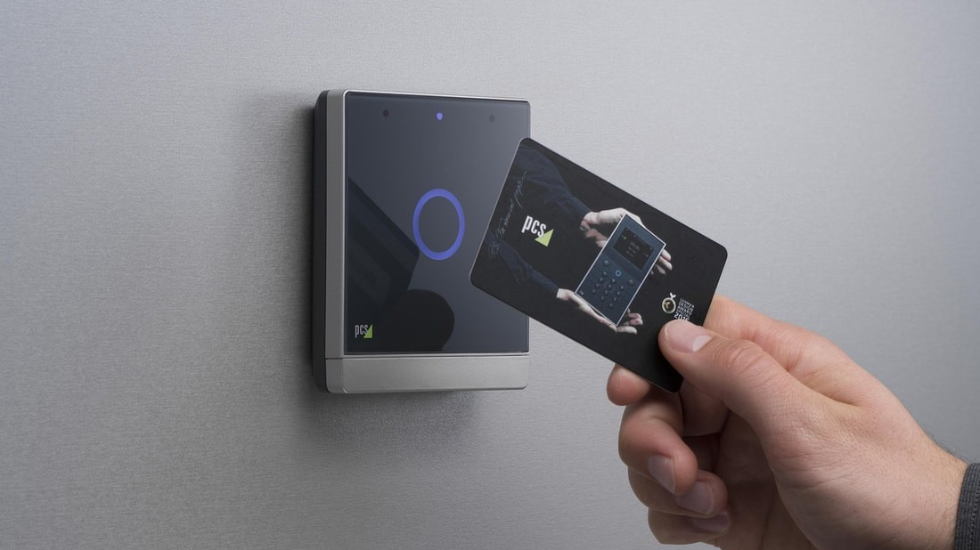
Radio frequency identification
7

Slide 8
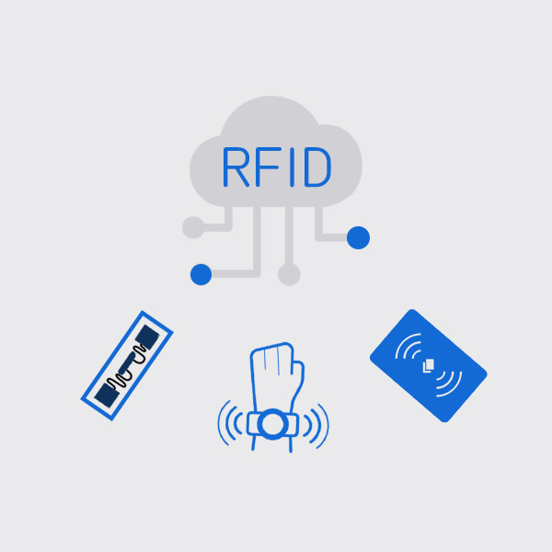
Introduction
Has a long history and is a part of both present andpast technological development.
Application:
– Inventory management – Asset tracking – Personnel tracking – Controlling access to restricted areas – ID Badging – Supply chain management
8

Slide 9
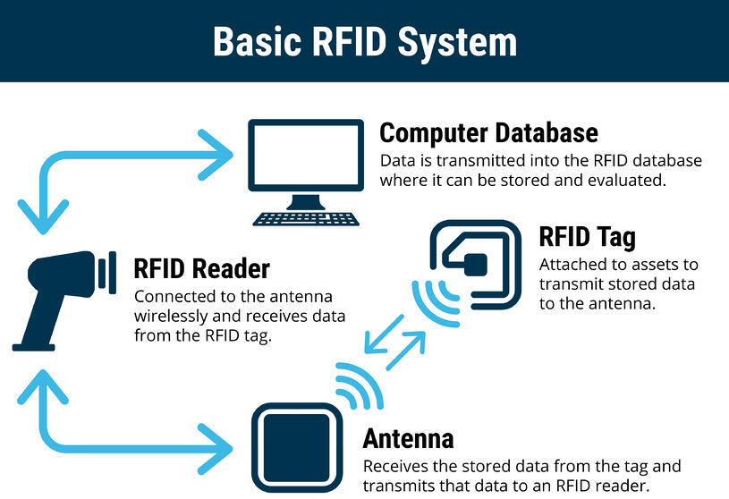
RFID system components
9

Slide 10
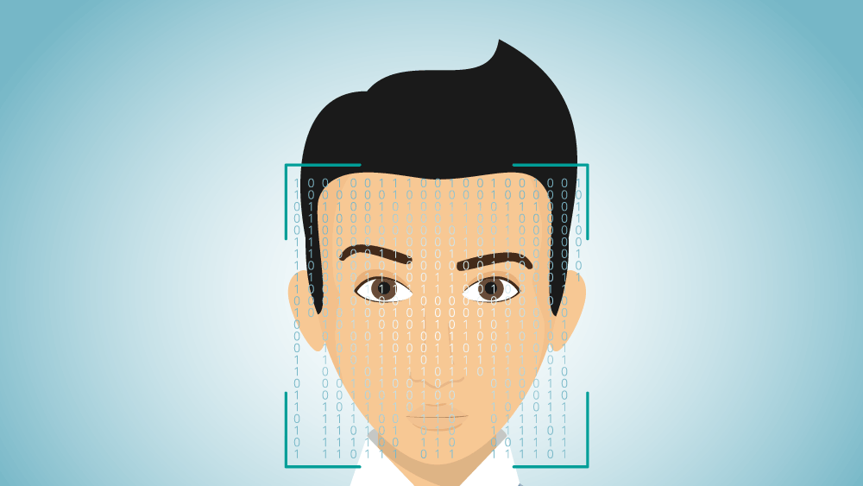
Face Recognition
10

Slide 11

Face detection
A computer technology being used in a variety of applications that identifies human faces in digital images.
Face detection can be regarded as a specific case of object-class detection.
Face-detection algorithms focus on the detection of frontal human faces.
11

Slide 12
Face recognition
Face recognition systems can be used to identify people in photos, video, or in real-time.
The face detection process is an essential step as it detects and locates human faces in images and videos.
The face capture process transforms analog information (a face) into a set of digital information (data) based on the person's facial features.
The face match process verifies if two faces belong to the same person.
12

Slide 13
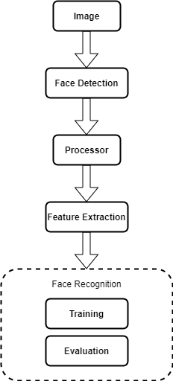
Face Recognition
13

Slide 14
Lbp (Local binary patterns) cascade classifier
To convert the image to grayscale.
For each pixel in the grayscale image, we select a neighborhood of size r surrounding the center pixel.
A LBP value is then calculated for this center pixel and stored in the output 2D array with the same width and height as the input image.
14

Slide 15
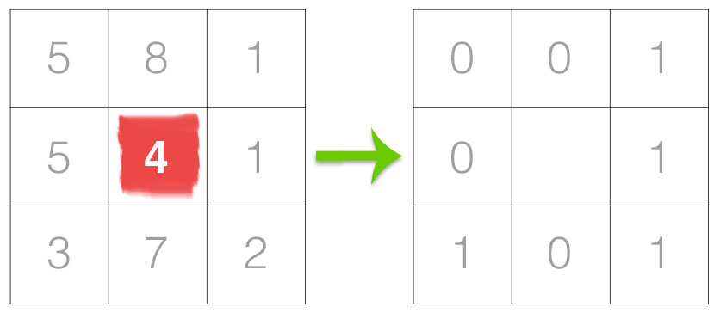
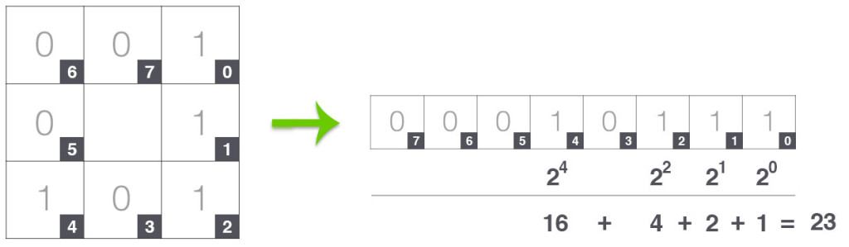
Lbp (Local binary patterns) cascade classifier
14

Slide 16
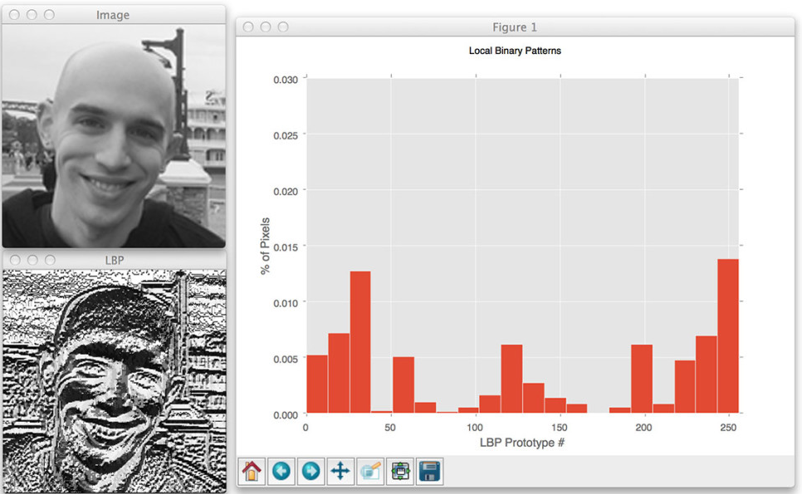
15

Slide 17

Opencv
OpenCV (Open Source Computer Vision Library) is an open source computer vision and machine learning software library.
Detect and recognize faces, identify objects, classify human actions in videos, track camera movements, track moving objects, etc.
Supports Windows, Linux, Android and Mac OS.
17

Slide 18
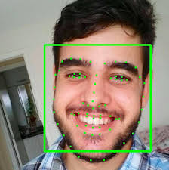
Facial landmarks
18

Slide 19
Facial landmarks
Facial landmarks are used to localize and represent salient regions of the face, such as: (eyes, eyebrows, nose, mouth, jawline)
Face alignment, head pose estimation, face swapping, blinl detection, etc.
19

Slide 20
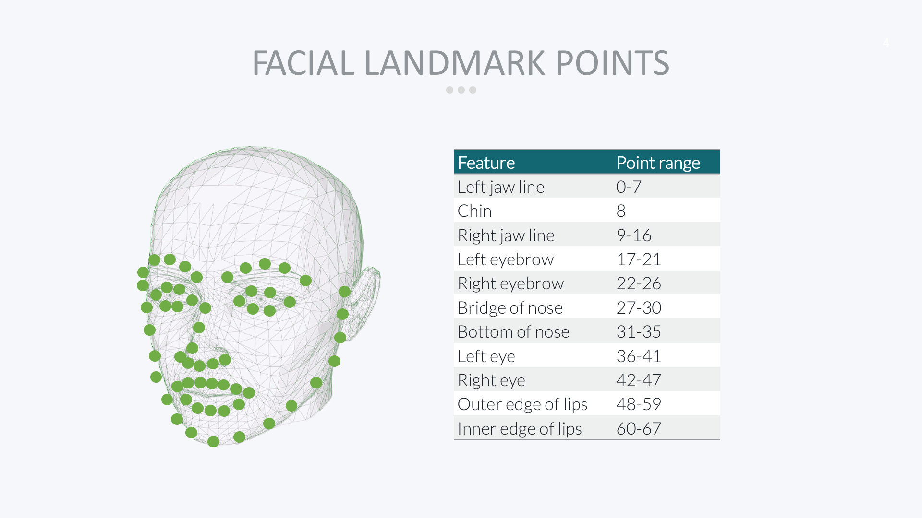
19

Slide 21
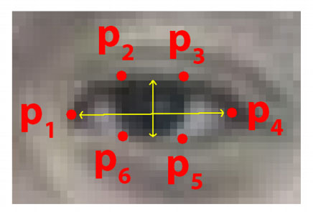
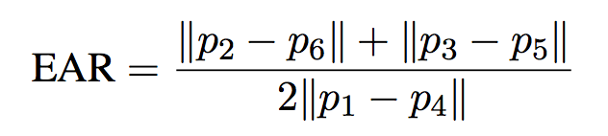
Eye aspect ratio (Ear)
Each eye is represented by 6 (x, y)-coordinates
There is a relation between the width and the height of these coordinates
21

Slide 22
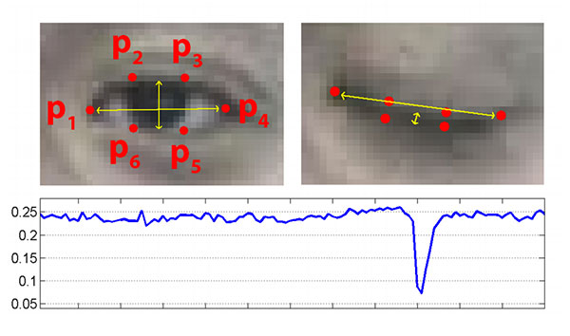
21

Slide 23
Methodology
Planning
Analysis
Design
Implementation
<number>

Slide 24

Planning
Problems
Traditional
RFID
Face Recognition
Fingerprint
Number of students
<number>

Slide 25

Analysis
RFID + Facial Recognition
<number>

Slide 26
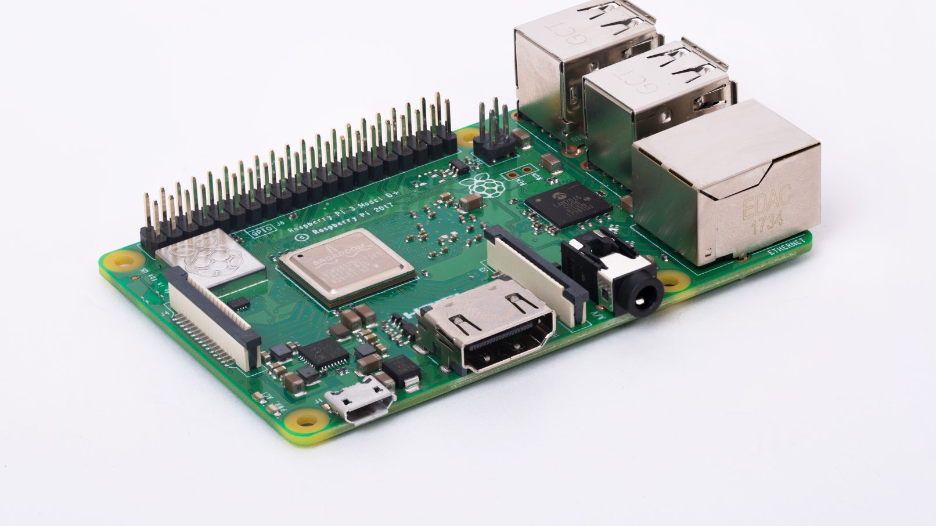
Design
<number>

Slide 27
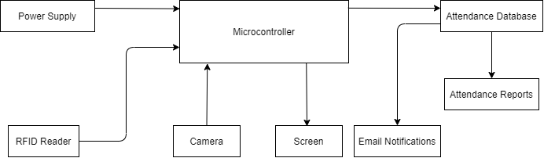
System Overview
<number>

Slide 28
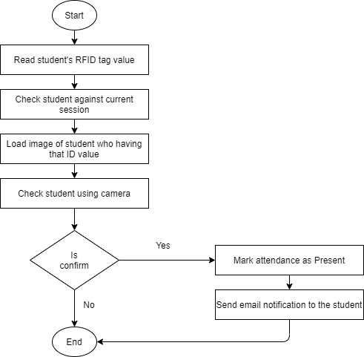
Flowchart
<number>

Slide 29
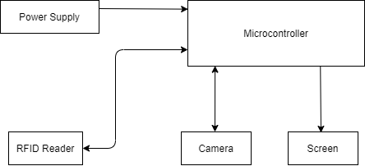
SYSTEM DESIGN
<number>

Slide 30

<number>

Slide 31
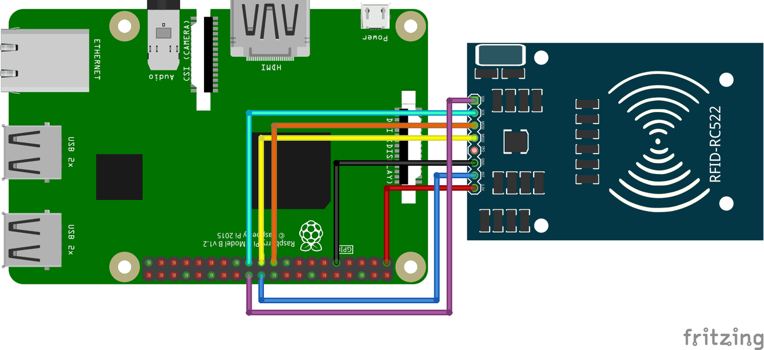
<number>

Slide 32
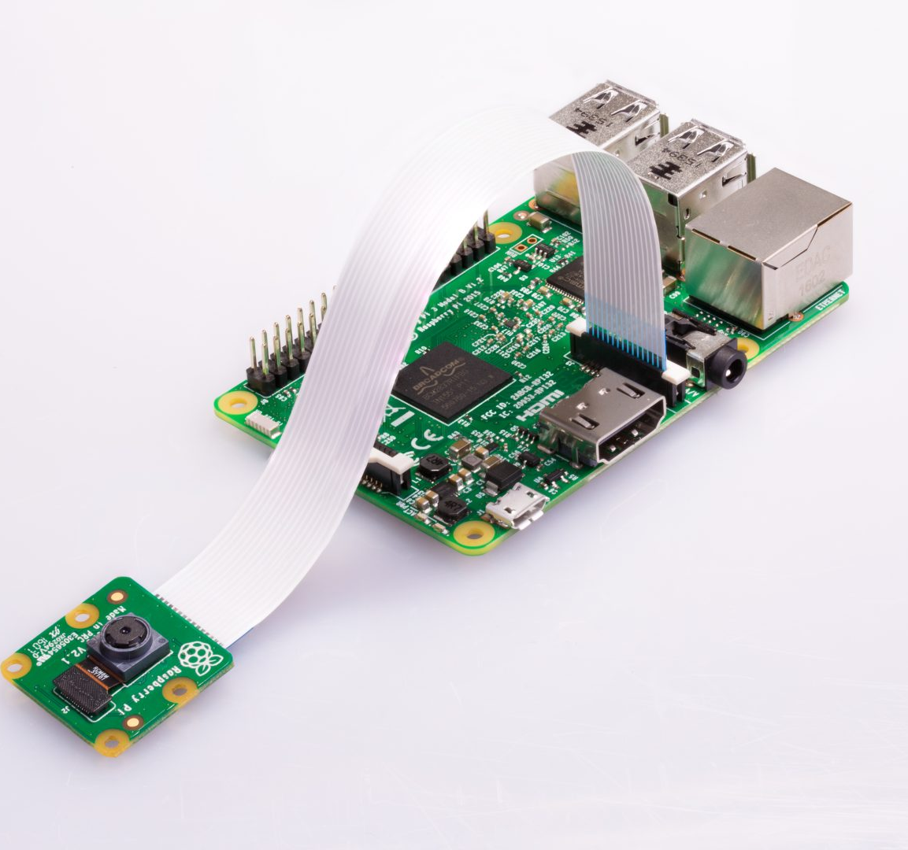
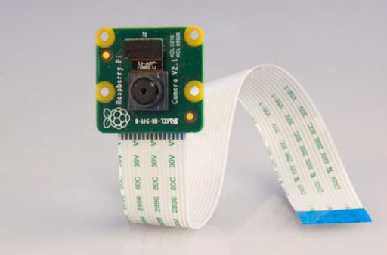
<number>

Slide 33
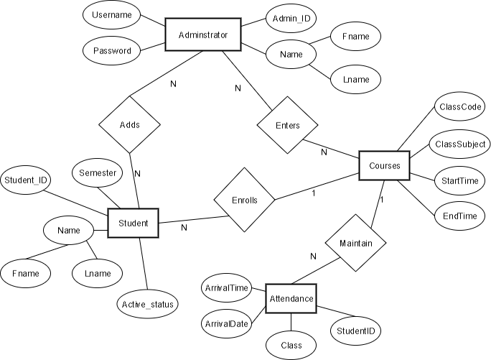
Er DIAGRAM OF DATABASE
<number>

Slide 34
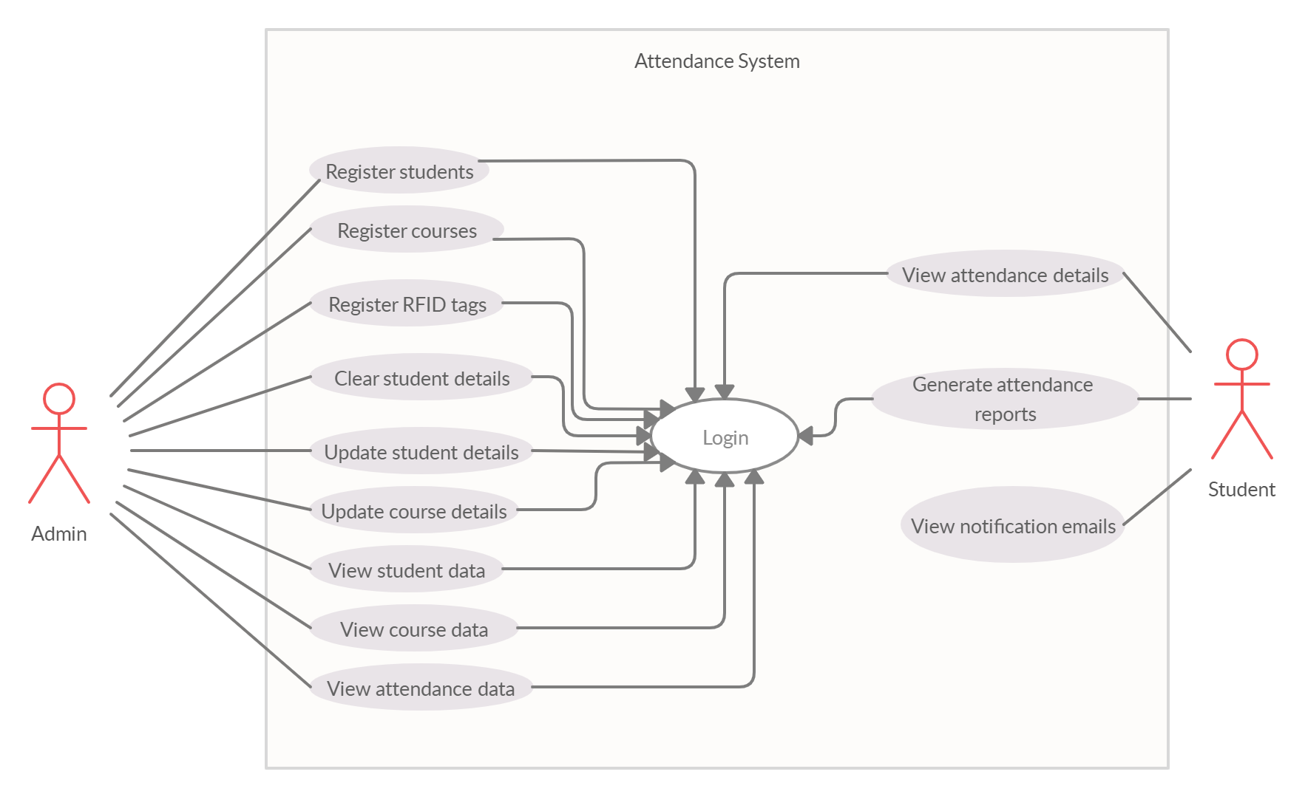
Usecase diagram
<number>

Slide 35

implementation
<number>

Slide 36
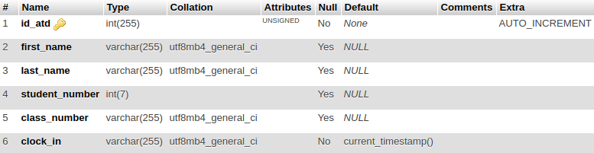
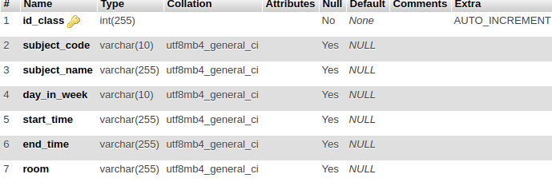
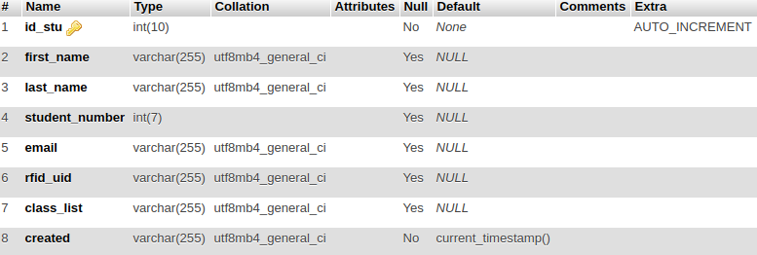
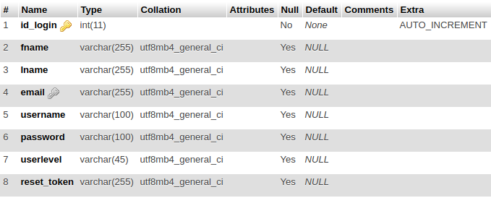
Database
<number>

Slide 37

python app
<number>

Slide 38
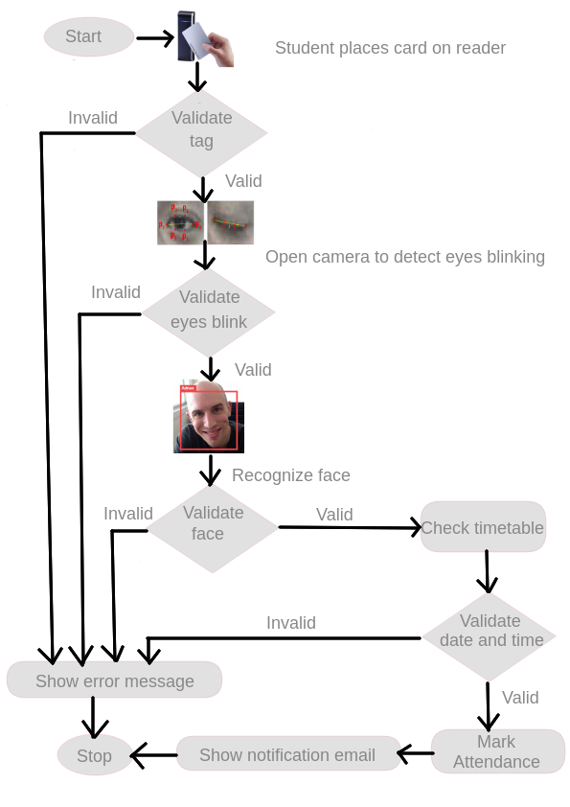
Marking attendance
<number>

Slide 39
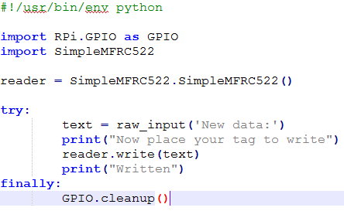
RFID
<number>

Slide 40
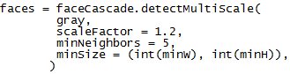
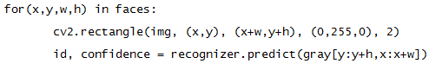
Face detection
<number>

Slide 41
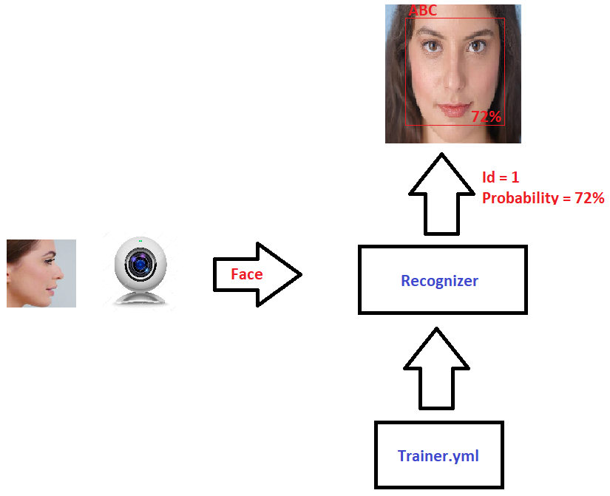
face recognition
<number>

Slide 42
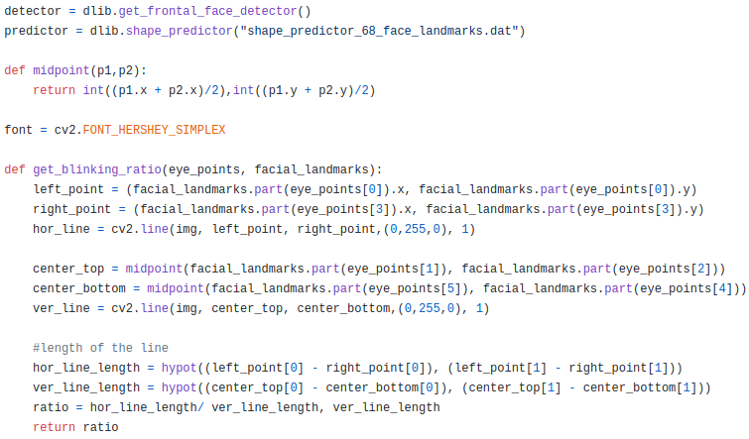
Eye blink detection
<number>

Slide 43
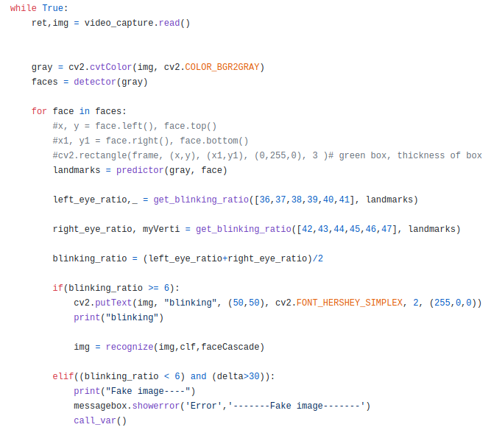
Eye blink detection
<number>

Slide 44
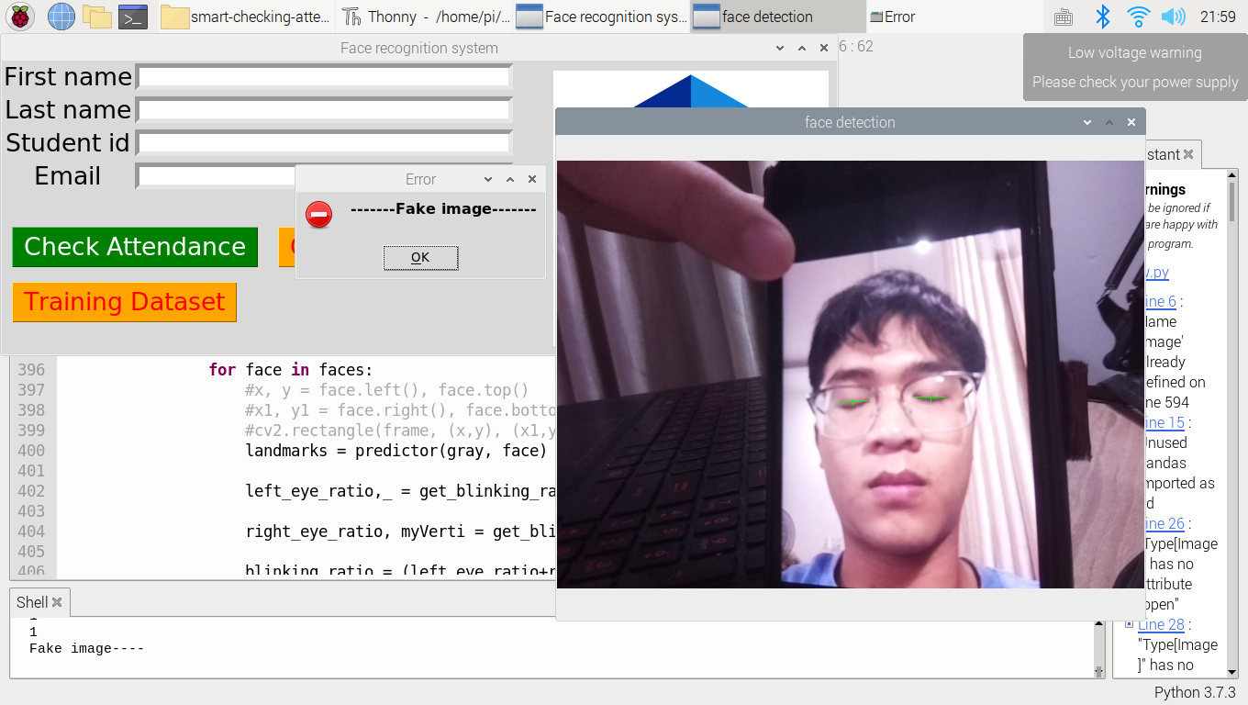
<number>

Slide 45
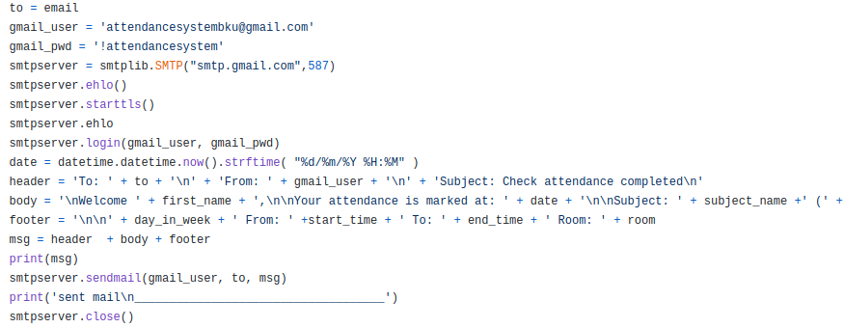
Send mail
<number>

Slide 46
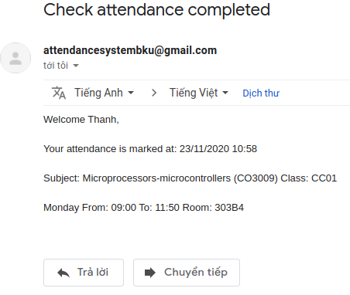
Send mail
<number>

Slide 47
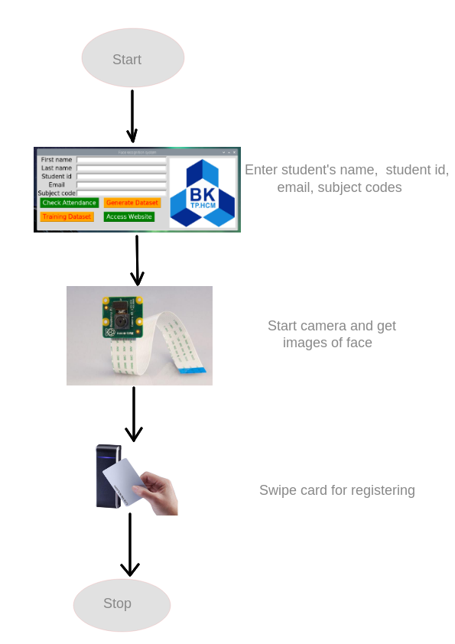
Register
<number>

Slide 48

Web app
<number>

Slide 49
Web app
Html, CSS, JavaScript, Ajax, Bootstrap, etc.
3 roles: admin, teacher, student
Data charts, search bar
Login, logout with session
Registration
Forgot password, confirm via email token
<number>

Slide 50
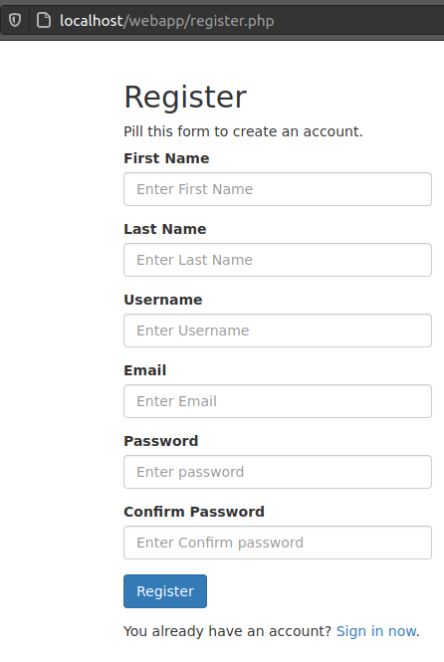
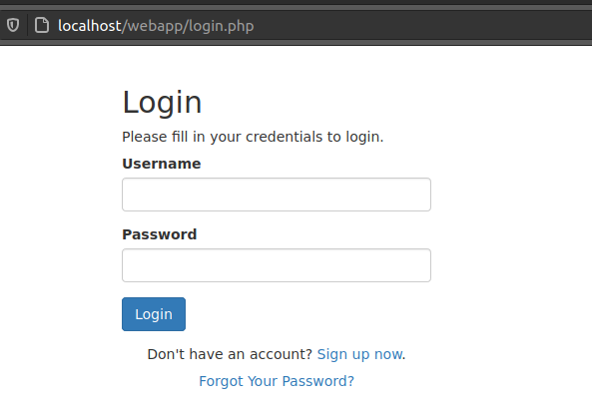
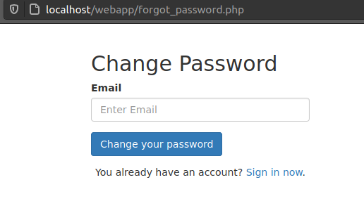
<number>

Slide 51
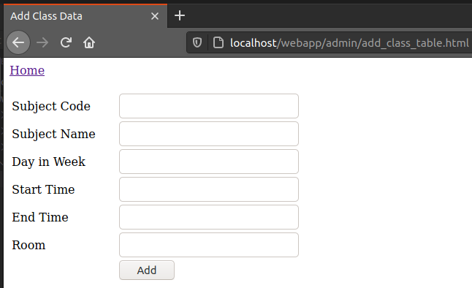
Admin
<number>

Slide 52
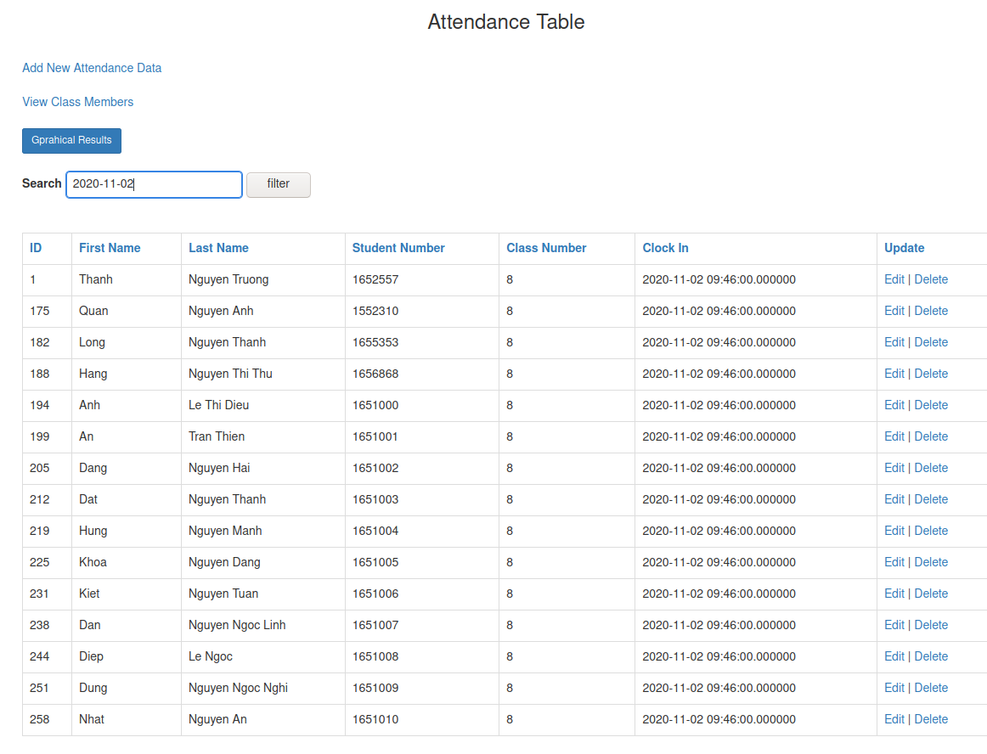
teacher
<number>

Slide 53
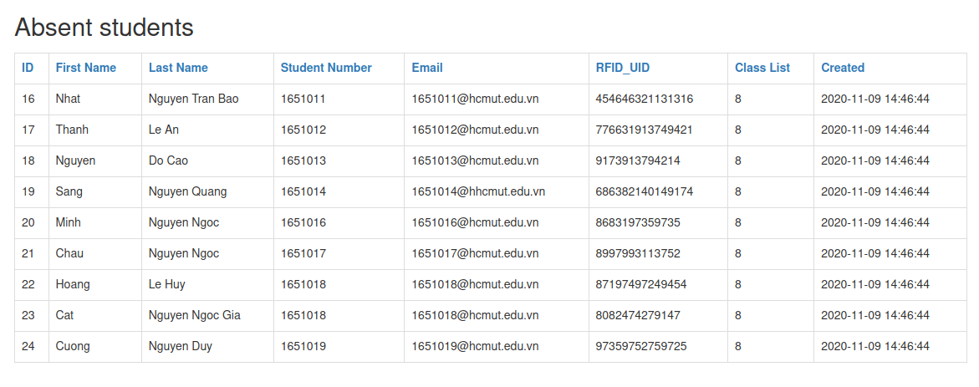
teacher
<number>

Slide 54
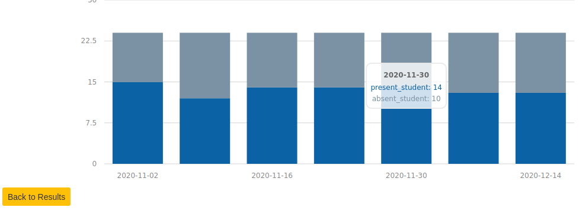
Attendance chart
<number>

Slide 55
Evaluation and testing
Testing
Evaluation
<number>

Slide 56

testing
<number>

Slide 57
testing
Time (s) | 1 | 2 | 3 | 4 | 5 | 6 | 7 | 8 | 9 | 10 | Average | Accuracy
Register | 87 | 93 | 86 | 72 | 100 | 69 | 91 | 110 | 98 | 105 | 91.1 | \
Correct all | 56 | 58 | 43 | 61 | 63 | 54 | 59 | 60 | 64 | 62 | 58 | 47/50 = 94 %
Wrong timetable | 50 | 41 | 48 | 42 | 39 | 46 | 43 | 39 | 49 | 34 | 43.2 | 49/50 = 98 %
Other face in db | 32 | 30 | 34 | 42 | 37 | 43 | 34 | 30 | 41 | 29 | 35.2 | 46/50 = 92 %
Unknown face | 30 | 32 | 37 | 40 | 33 | 44 | 45 | 51 | 38 | 33 | 38.3 | 49/50 = 98 %
Unregistered card | 26 | 25 | 31 | 28 | 27 | 29 | 31 | 28 | 25 | 29 | 27.9 | 50/50 = 100 %
Fake image | 75 | 78 | 80 | 77 | 81 | 79 | 86 | 76 | 84 | 87 | 80.3 | 50/50 = 100 %
<number>

Slide 58

Evaluation
<number>

Slide 59
Evaluation
Advantages
The system is easy to setup
Have all a checking attendance system need
Have data chart
Low cost
Disadvantages
Timing constraint
Low capacity of RAM
User interface is not good
Localhost
<number>

Slide 60
conclusion
Contributions
Result
Future Works
<number>

Slide 61

Contributions
Give a solution to check student attendance using IoT devices.
Combine RFID and Facial recognition
Detect fake image of faces
<number>

Slide 62

result
<number>

Slide 63

Future work
Setup web server and database server to another hosting
Move the project to the stronger system
Use other methods to improve the efficiency of anti-spoofing to replace eye blink detection
Create a better user interface
Improved code logic of the system
<number>

Slide 64

Thank you any question?
<number>

